Slide 1



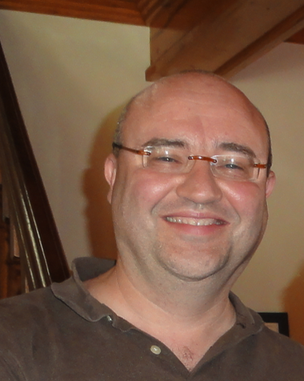
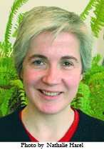
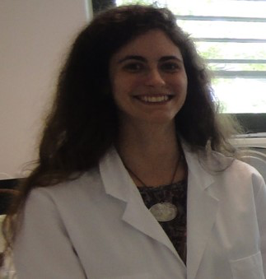
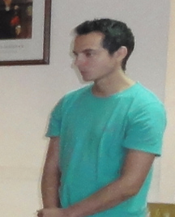


Modeling sunflower fungal complex to help design Integrated Pest Management strategies
Jean-Noël Aubertot
Emmanuelle Mestries
Marie-Anne Vedy-Zecchini
Arnaud Allègre
Pierre Casadebaig
Philippe Debaeke

Slide 2
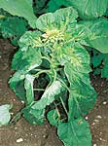
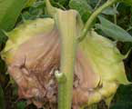
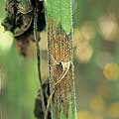
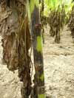
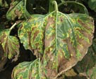
A yield limiting fungal complex
(non-exhaustive list!, cf. presentation of Prof Maširevič yesterday)
Downy mildew (Plasmopara halstedii)
White mold (Sclerotinia sclerotiorum)
Phomopsis stem canker
(Diaporthe helianthi)
Phoma black stem (Phoma macdonaldii)
Verticillium (Verticillium dahliae)

Slide 3
How to contain fungal complexes
in a variety of production situations?
Cropping practices
Severity (%)
Soil and climate
Landscape

Slide 4
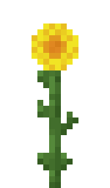
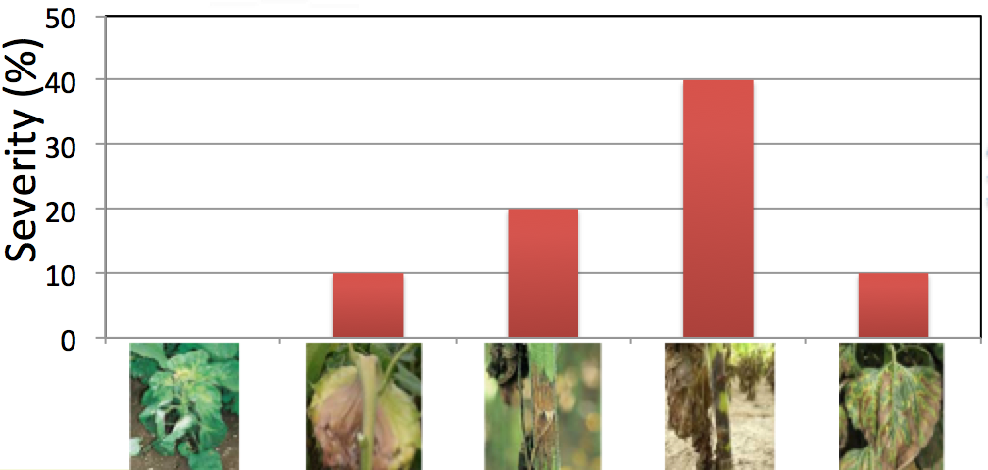
How to handle such a level of complexity?
Input variables
Model
Output variables
Cropping practices
Soil and climate
Modèles existants
Landscape

Slide 5


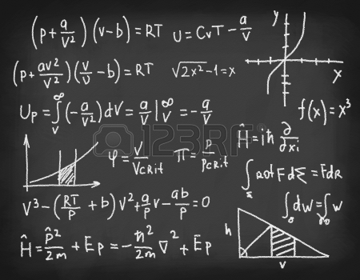
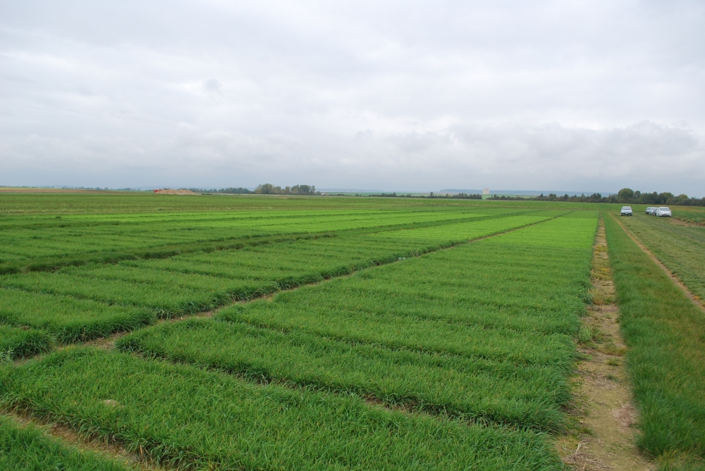
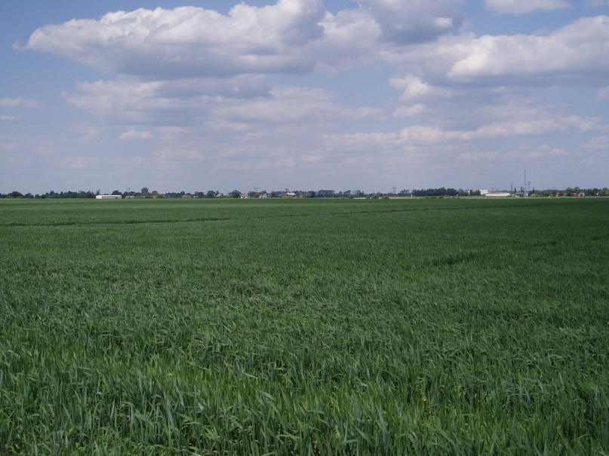
How to produce knowledge useful for IPM of fungal complexes on sunflower?
Expert knowledge
Integration
Scientific and
technical litterature
Modèles existants
Analyses
bibliographiques
Models
Experiments
Diagnoses in
commercial fields

Slide 6
Need for methodological modelling breakthroughts that:
- permit integration of various sources of knowledge
- address a higher level of complexity than present crop and epidemiological models
- permit horizontal and vertical integration for IPM
- reduce the gap between « scientific modelers » and end users
- contribute to training

Slide 7
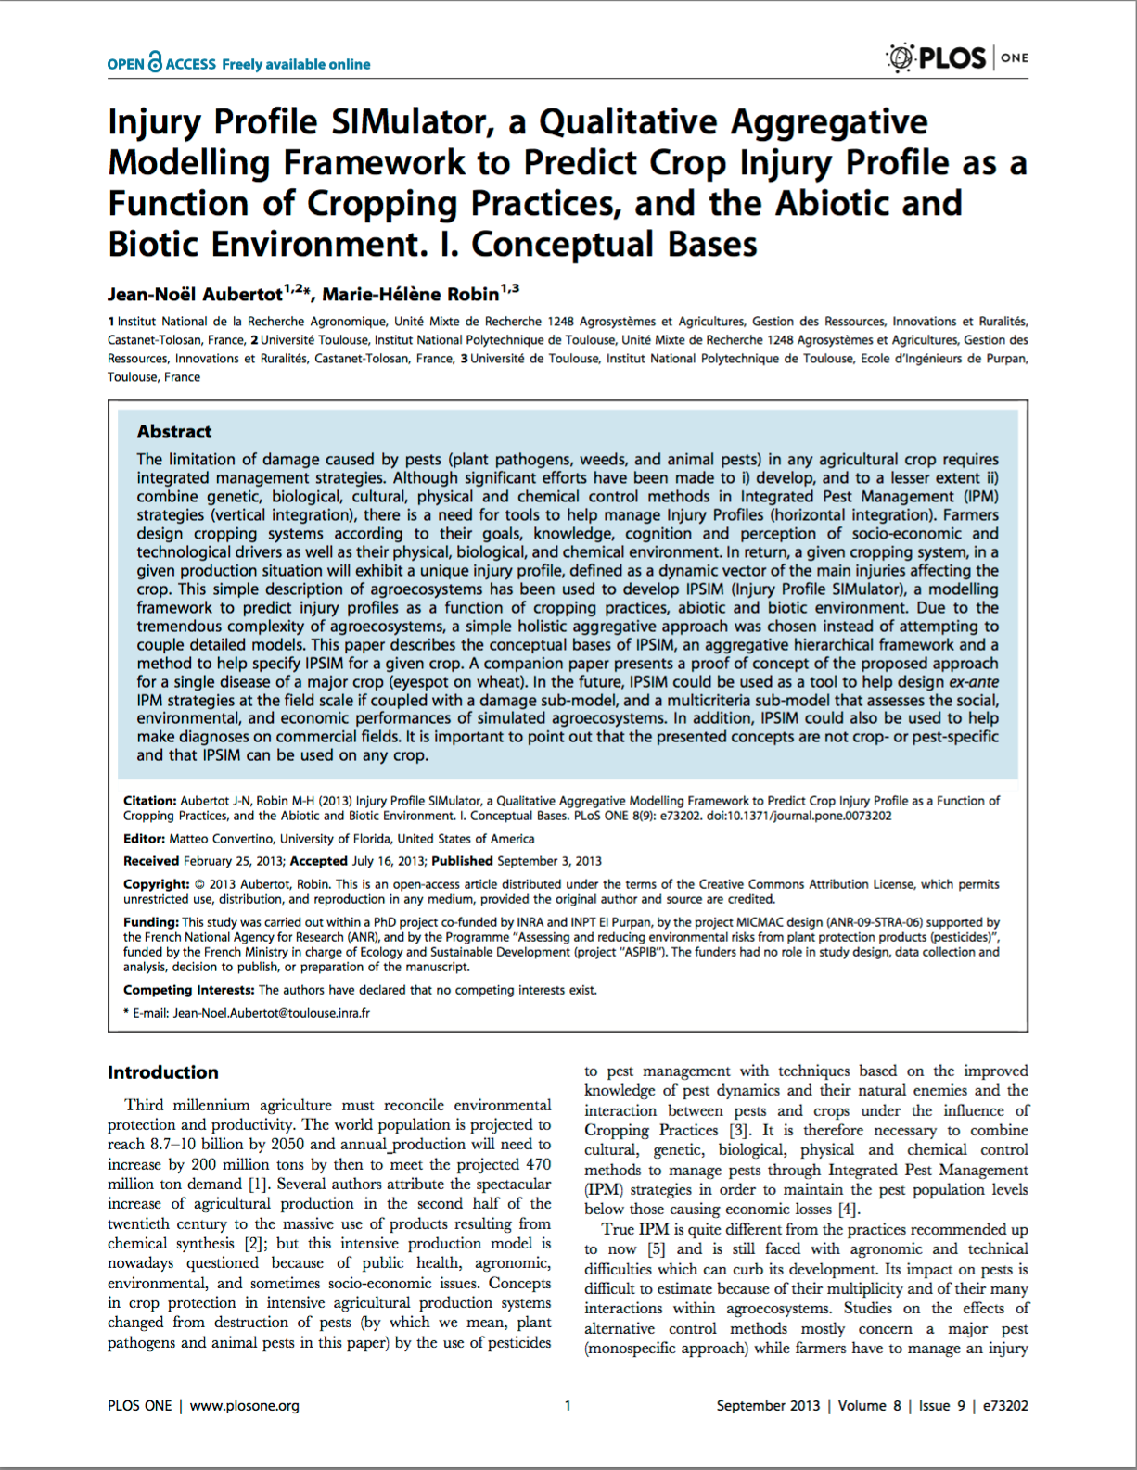
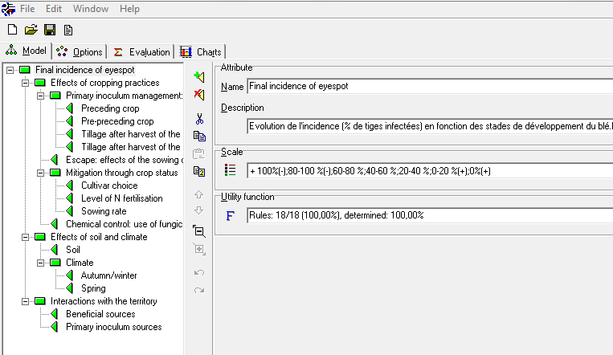
The IPSIM platform
fulfills the above mentioned objectives
permits to design simulation models without equations!
use the user friendly software DEXi:
http://www-ai.ijs.si/MarkoBohanec/dexi.html

Slide 8
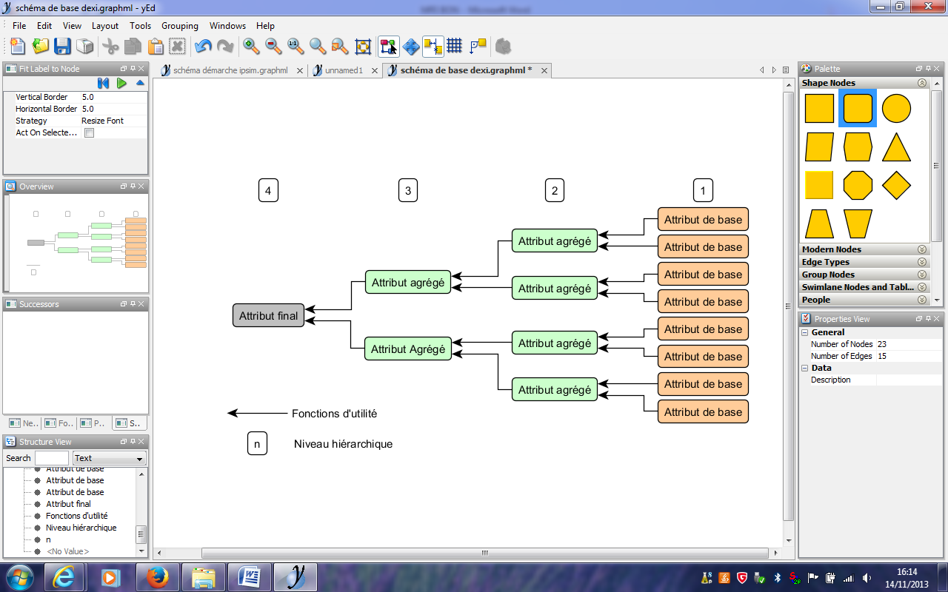
An example of deterministic hierarchical Bayesian network
(with ordinal or nominal attributes)
Input attribute
Aggregated attribute
Input attribute
Input attribute
Aggregated attribute
Aggregated attribute
Input attribute
Final attribute
Input attribute
Aggregated attribute
Aggregated attribute
Input attribute
Aggregated attribute
Input attribute
Aggregating tables
Input attribute
Hierarchical level

Slide 9
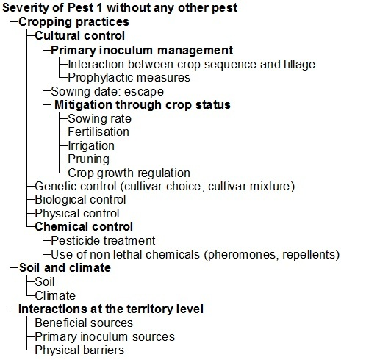
Generic structure of IPSIM

Slide 10
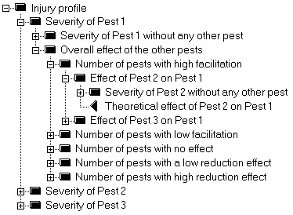
How interactions among
pests are taken into
account in IPSIM

Slide 11
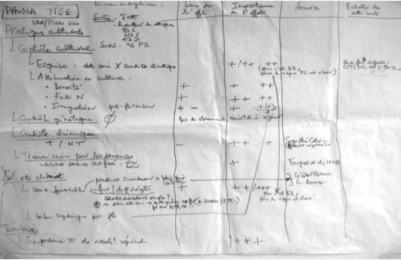
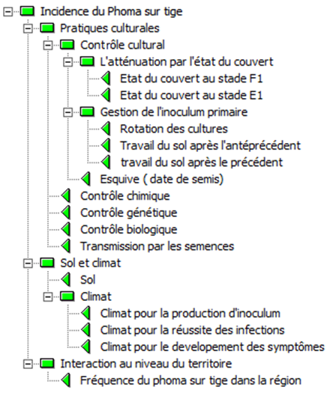
Phoma black stem on sunflower

Slide 12
Phoma black stem on sunflower (1 of the 8 aggregative tables)
Cropping practices | Soil&weather | Landscape | Severity
Favourable to the disease | Favourable | Favourable | High
Favourable to the disease | Favourable | Unfavourable | Medium
Favourable to the disease | Unfavourable | Favourable | Medium
Favourable to the disease | Unfavourable | Unfavourable | Null to low
Slightly favourable to the disease | Favourable | Favourable | High
Slightly favourable to the disease | Favourable | Unfavourable | Medium
Slightly favourable to the disease | Unfavourable | Favourable | Null to low
Slightly favourable to the disease | Unfavourable | Unfavourable | Null to low
Unfavourable to the disease | Favourable | Favourable | Medium
Unfavourable to the disease | Favourable | Unfavourable | Medium
Unfavourable to the disease | Unfavourable | Favourable | Null to low
Unfavourable to the disease | Unfavourable | Unfavourable | Null to low

Slide 13
Design of a converter for IPSIM-SUNFLOWER-Phoma Stem Canker
(from nominal and quantitative variables to ordinal variables)
Weather/ primary inoculum production
Weather / infections
Weather / injury development
Crop status at flowering
Crop status at bud stage
Crop sequence
Tillage after harvest of pre-preceeding crop
Tillage after harvest of preceeding crop
Sowing date
Chemical control
Genetic control
Biological control
Seed transmission
Soil
Phoma stem canker prevalence at the landscape level
Daily weather data
SUNFLO model
Cropping system description
Soil description
Landscape description

Slide 14
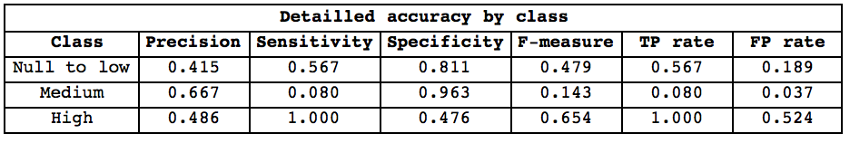
Quality of prediction of
IPSIM-SUNFLOWER-PHOMA BLACK STEM

Slide 15
3 simulation examples
 |  |  |  | Midi-Pyrénées, 1999 | Midi-Pyrénées, 2000 | Poitou-Charentes, 2007
Crop status at flowering |  |  |  | Unfavorable to the disease | Favorable to the disease | Favorable to the disease
Crop status at bud stage |  |  |  | Unfavorable to the disease | Favorable to the disease | Favorable to the disease
Crop sequence |  |  |  | At least 3 year rotation | Sunflower every other year | Sunflower every other year
Tillage after harvest of pre-preceeding crop |  |  |  | Tillage without ploughing | Ploughing | Direct sowing
Tillage after harvest of preceeding crop |  |  |  | Ploughing | Tillage without ploughing | Direct sowing
Sowing date |  |  |  | Standard | Standard | Standard
Chemical control |  |  |  | No | Yes | No
Genetic control |  |  |  | No | No | No
Biological control |  |  |  | No | No | No
Seed transmission |  |  |  | No | No | No
Soil |  |  |  | Neutral | Neutral | Neutral
Weather/ primary inoculum production |  |  |  | Favorable to the disease | Favorable to the disease | Favorable to the disease
Weather / infections |  |  |  | Unfavorable to the disease | Favorable to the disease | Favorable to the disease
Weather / injury development |  |  |  | Favorable to the disease | Favorable to the disease | Favorable to the disease
Phoma stem canker prevalence at the landscape level |  |  |  | Favorable to the disease | Favorable to the disease | Favorable to the disease
Phoma stem canker severity |  |  |  | Null to low | Medium | High

Slide 16
Discussion
Methodological breakthroughts in modelling
- Combination of expert knowledge, existing models and data
- Fair predictive quality considering that no calibration was performed
- Transparent
- Very easy to develop and to present
- Great for communicating and teaching
- Better vertical and horizontal integrations in IPM
Perspectives
- Design of various sub-models : Downy mildew, White mold, Phomopsis stem canker, Phoma black stem, Verticillium, Broom rape, …
- Methodological developments
- PhD thesis starting September 2016

Slide 17

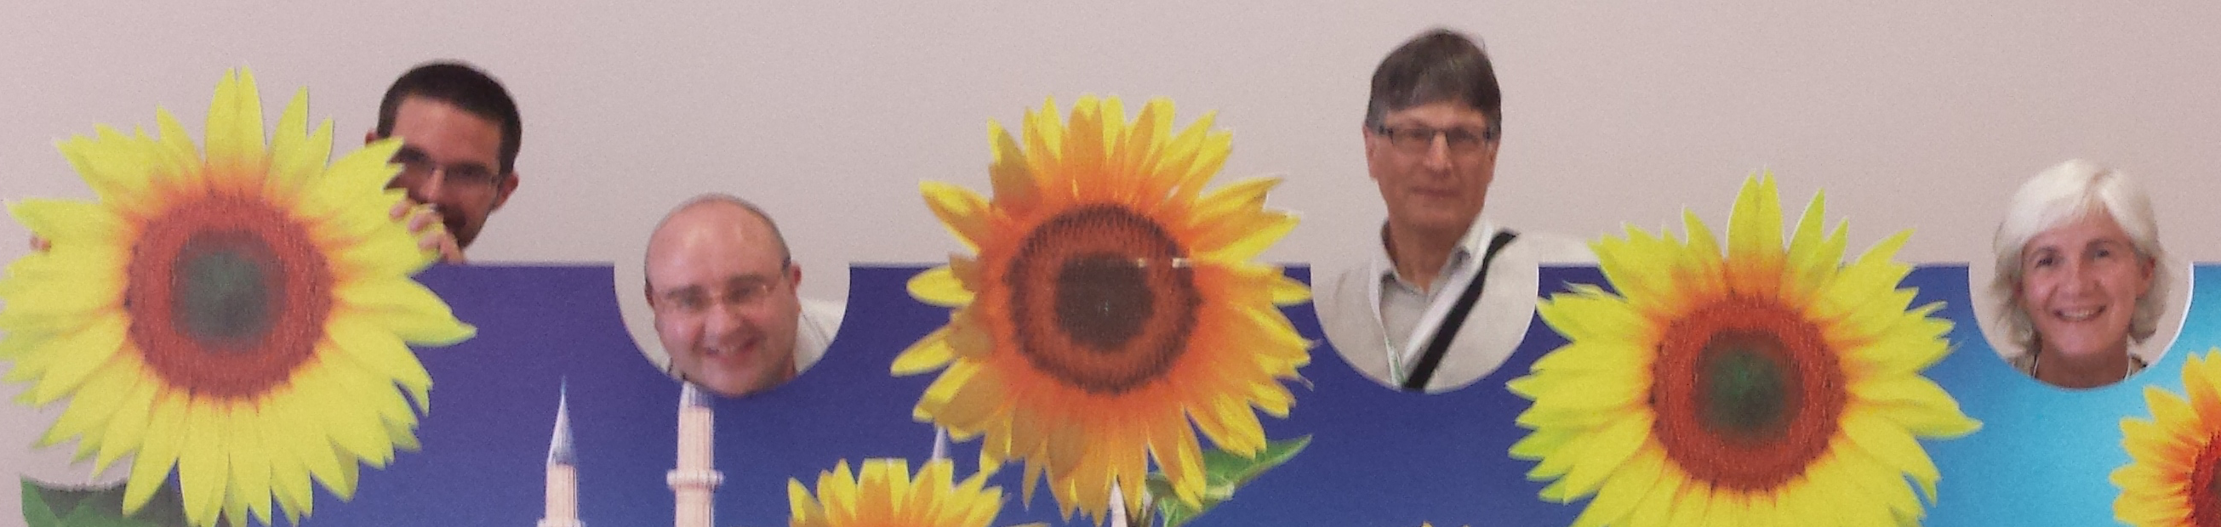
In the war against sunflower pests…
Expert knowledge
Simulation models
Datasets with description of cropping practices, soil&weather, landscape and pest injuries
Please send an email to:
Jean-Noel.Aubertot@toulouse.inra.fr
Or contact one of us!

